Slide 1
Pool Table
A Graphics Presentation by
Matthew Johnson
Alexander Novotny

Slide 2
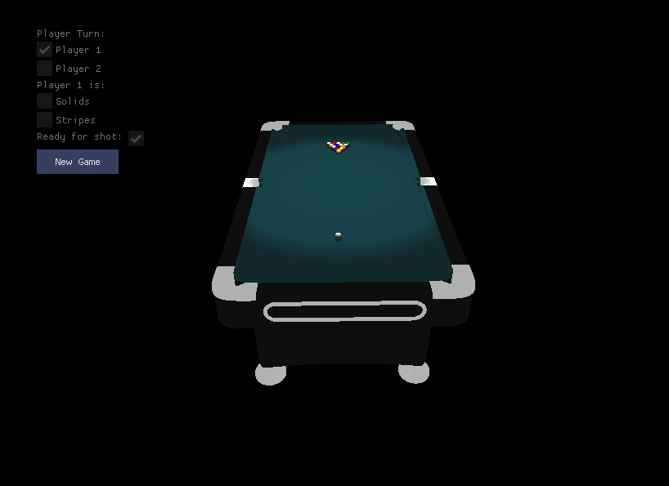
Overview
Models and textures for:
Billiard Balls
Pool Table
Game menu to show player turns and start new game

Slide 3
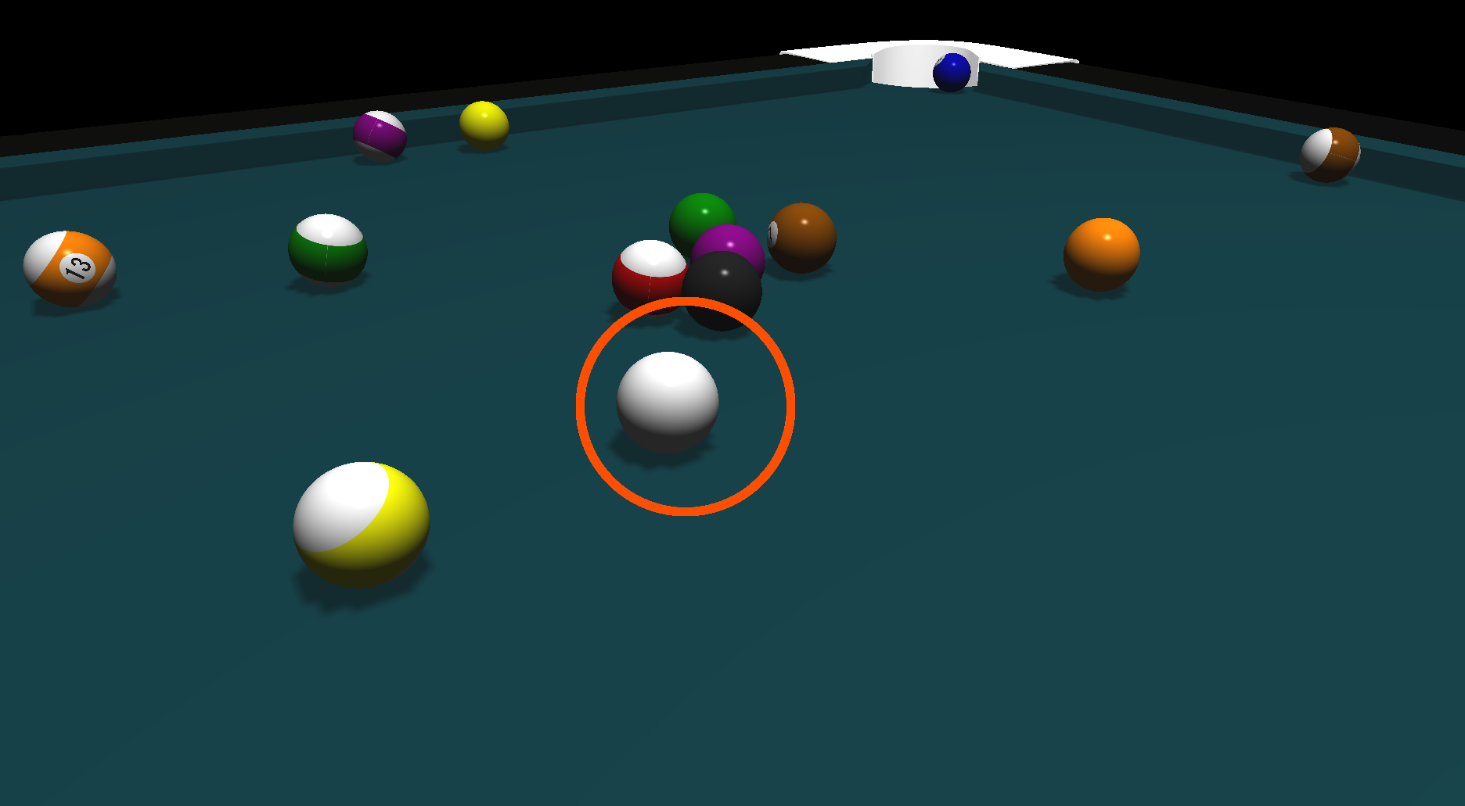
Interactivity
Camera can be moved to center the perfect shot
Can click on different parts of the cue ball to put spin on the ball
Holding the mouse button results in a charge-up meter – letting you control the power of your shots

Slide 4
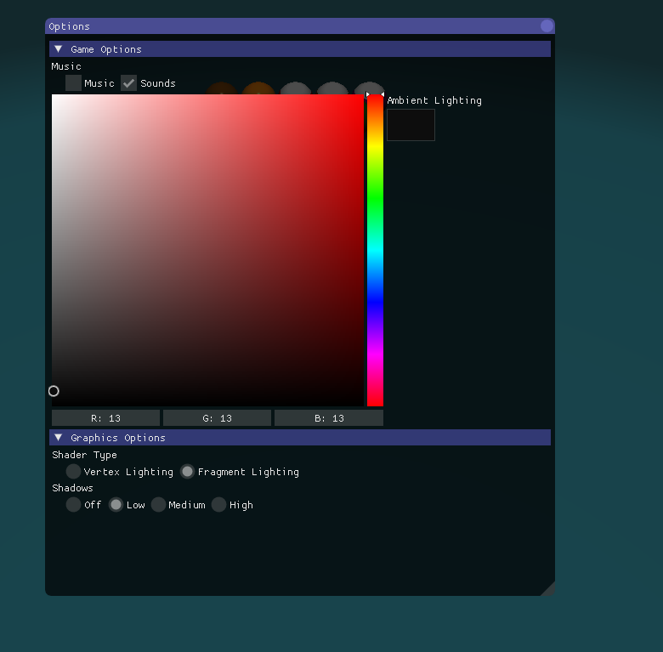
Options Menu
Control music and sounds, graphics quality, and lighting options

Slide 5
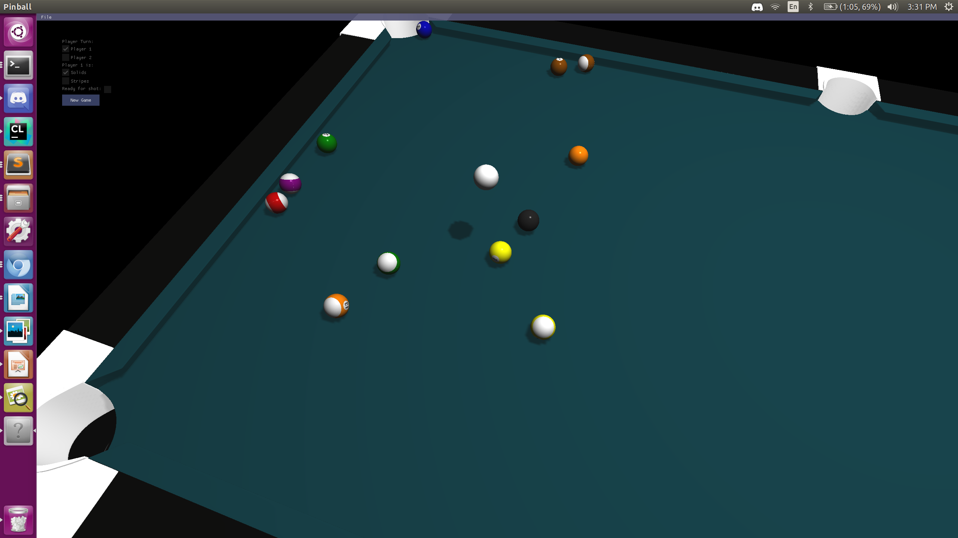
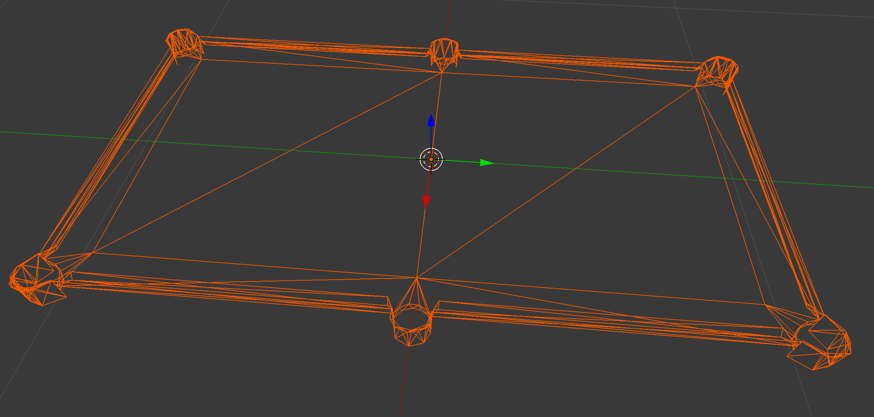
Physics
Collisions between pool balls and the pool table
Special collision mesh used for pool table which lets balls fall into holes, but doesn’t use as many vertices as rendered model

Slide 6
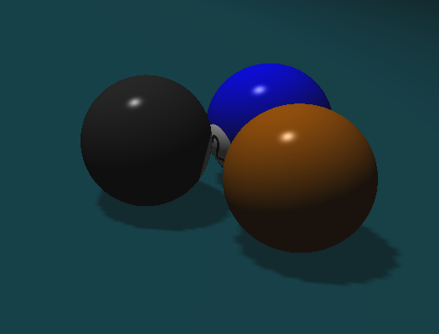
Lighting
Multiple spotlight support
Shadows
Phong Shading

Slide 7
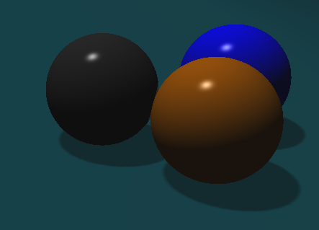
Shadow Quality
Low
High

Slide 8
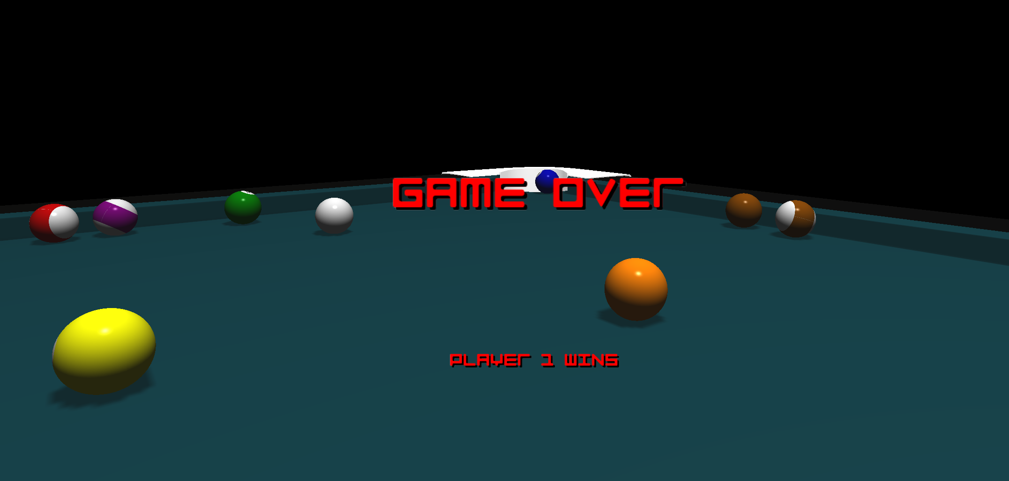
Billboards
Billboard system used for UI elements, such as charge up meter and game over screen

Slide 9
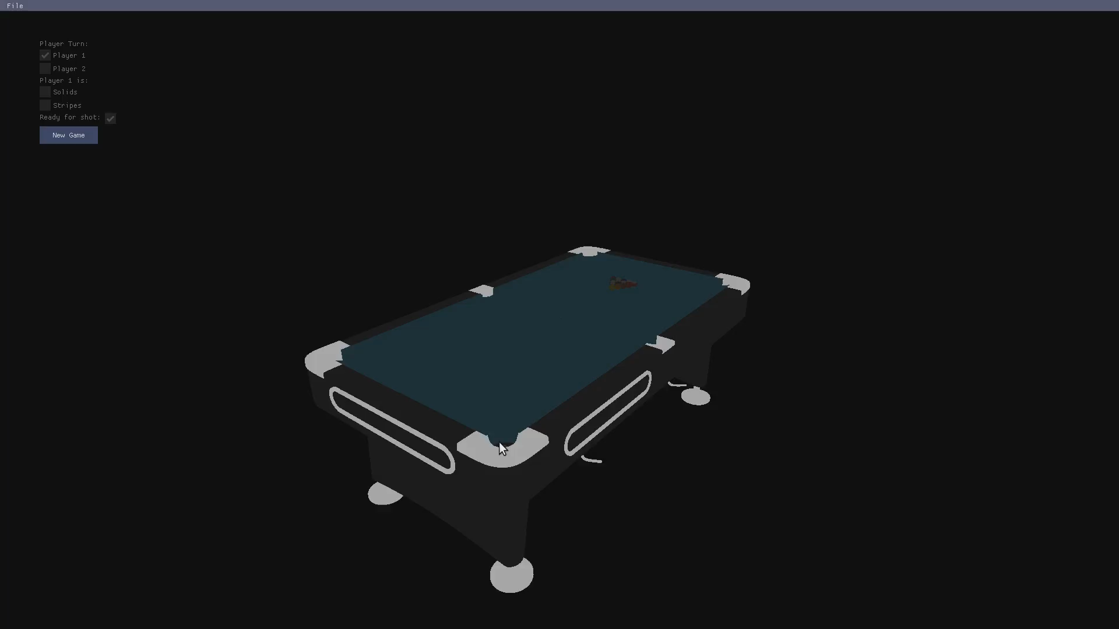
Demonstration

